Slide 1
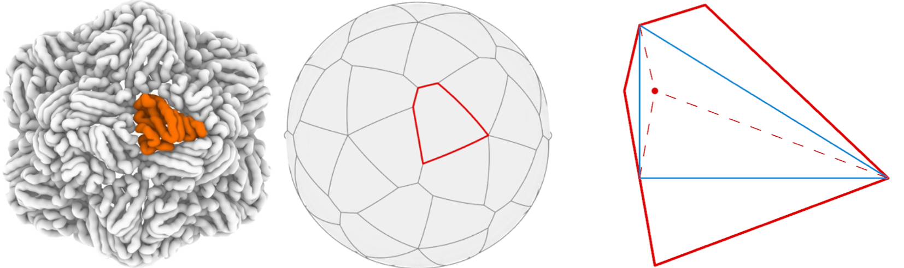
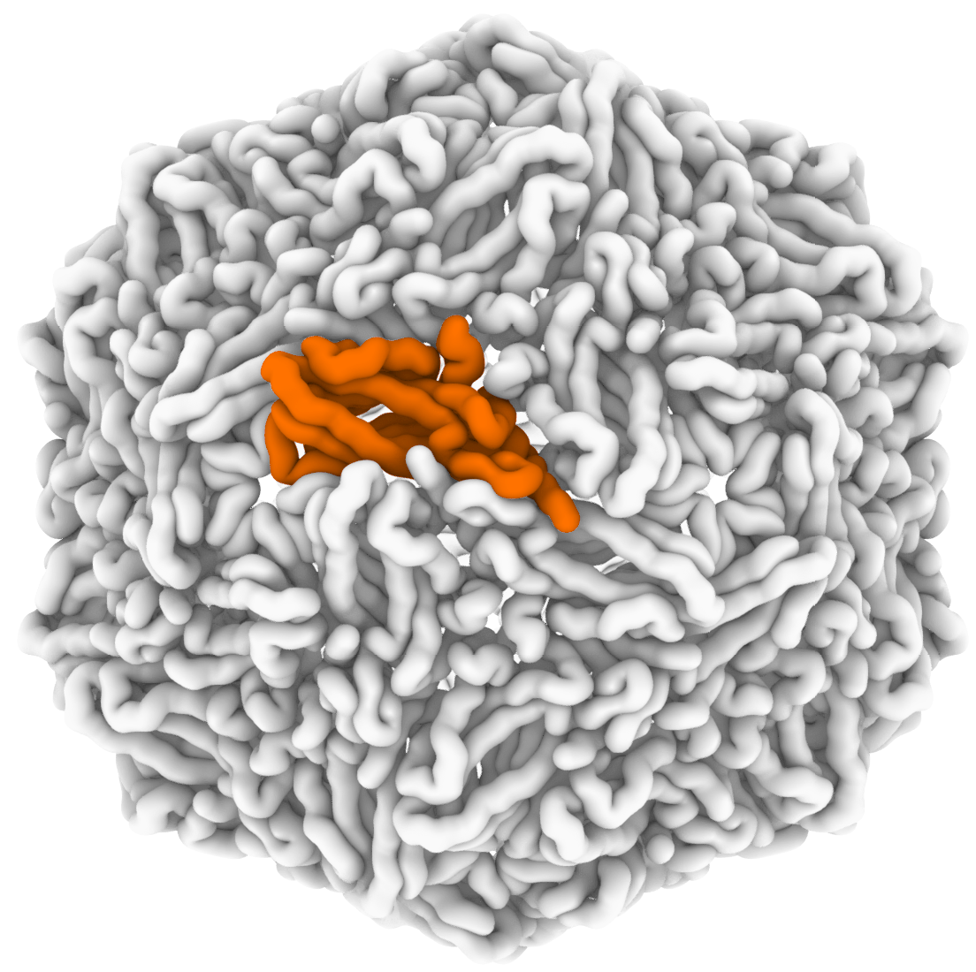
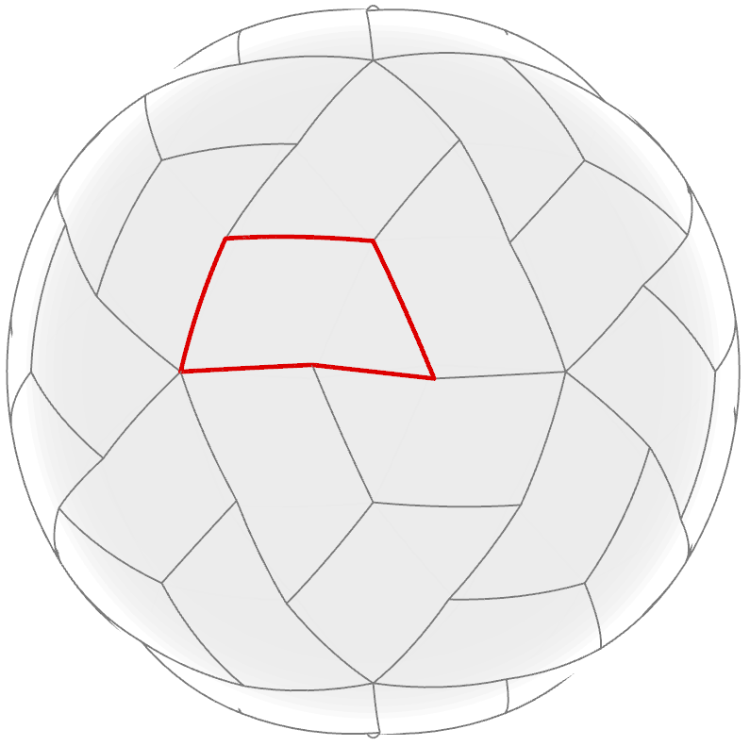
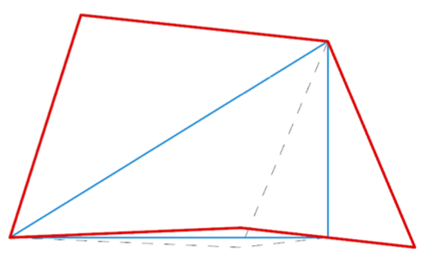
c
Faba bean necrotic stunt virus (PDB ID 6S44)
PCV2 virus-like particle (PDB ID 5ZJU)
3-fold
tile shape
junction
point
3-fold
junction
point
tile shape
2-fold
5-fold
5-fold
2-fold

